Slide 1




Walmart Sales Forecasting Project

Slide 2

Walmart Sales Forecasting
Author: Vasavi Kullanakoppal
Course: DSC 630 Predictive Analytics
Date: 5/23/2025
Forecasting Future Sales Using Historical and Economic Data

Slide 3
Introduction
Retailers struggle to anticipate demand fluctuations.
Objective: Use historical and macroeconomic data to predict weekly sales and aid in business planning.

Slide 4
Driving Questions
- Can we accurately forecast future sales?
- How do holidays and economic factors impact sales?
- Are certain features more predictive than others?

Slide 5
Dataset Overview
Source: Walmart dataset (Kaggle)
Period: Feb 2010 – Nov 2012
Fields:
- Store
- Date
- Weekly Sales
- Holiday Flag
- Temperature

Slide 6

Data Preparation
Steps taken:
- Reshaped data to long format (Year, Month, Sales)
- Created lag features (e.g., previous week sales)
- Encoded month/year for seasonality
- Merged macroeconomic and holiday data

Slide 7
Modeling Approach
Justification: Handles nonlinear relationships and multicollinearity well
Time-based train-test split to preserve sequence
Model Used: Random Forest Regressor

Slide 8

Evaluation Metrics
Mean Absolute Error (MAE): ~76,546
Root Mean Squared Error (RMSE): ~110,366
Indicates decent prediction capability, with potential deviations at peak times

Slide 9
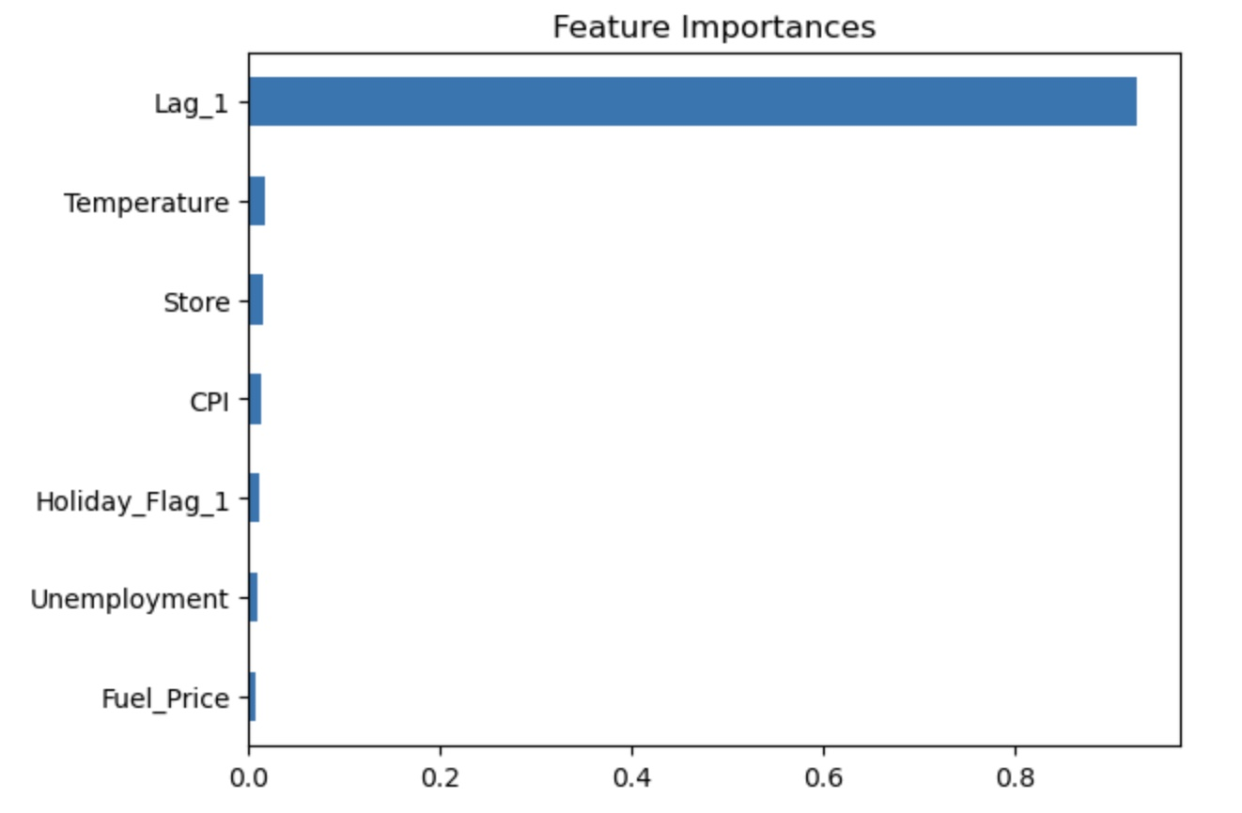
Model Interpretation
Feature Importance:
Lag_1 (Previous Week Sales) was the strongest predictor
Macroeconomic variables had minimal impact
Suggests sales depend heavily on past performance

Slide 10
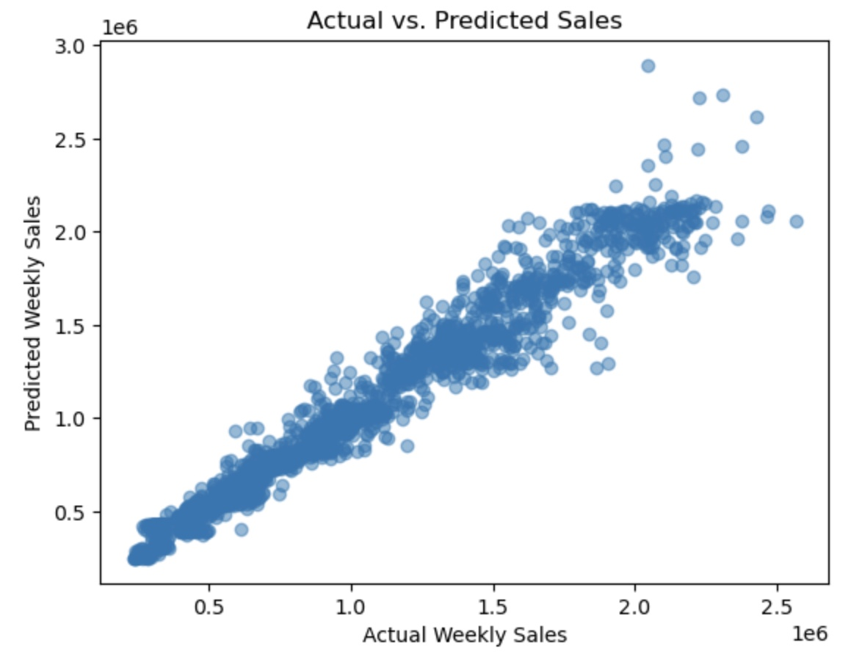
Predicted vs. Actual Sales
Insight: Good fit overall, with slight divergence during high-volume weeks

Slide 11
Findings
Sales predictions are reliable based on historical data
External factors have limited short-term predictive power
Seasonality and event markers (e.g., holidays) matter

Slide 12
recommendations
Invest in systems for historical sales tracking
1
Introduce flags for major retail events (e.g., Black Friday)
2
Calibrate models during peak season to enhance precision
3

Slide 13
Challenges and risks
Missing/inconsistent data
Macro variables may be too coarse
Over-reliance on forecasts may impact inventory/staffing

Slide 14
Ethical considerations
Avoid bias in predictions by periodic retraining
Maintain transparency with modeling assumptions
Forecasts should guide—not dictate—business decisions

Slide 15
Alternative approaches
Explore ARIMA/SARIMA for trend analysis
Consider LSTM for capturing deep sequential patterns
Integrate external datasets (e.g., weather APIs)

Slide 16
conclusion
Historical data is a powerful forecasting tool.
Random Forest model provides a strong baseline for weekly sales prediction.
Continued feature engineering and tuning will boost performance.

Slide 17
Next steps
Automate data updates and retraining
Implement in-store dashboards for actionable insights
Evaluate other models and features for improvements

Slide 18
references
Walmart Dataset (Kaggle): https://www.kaggle.com/datasets/yasserh/walmart-dataset
Course Materials
Research on Retail Forecasting and Time Series Analysis

Slide 19

Contact details
vkullanakoppal@my365.bellevue.edu

